Slide 1
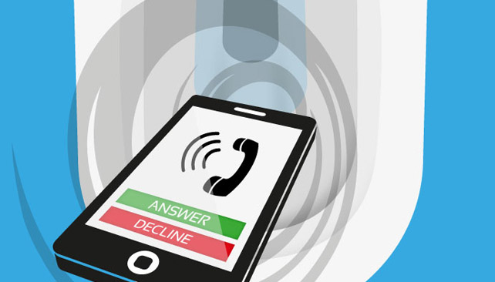
Phone Dump
Solving first world problems for the third world

Slide 2
Team Phone Dump
Jordan Knight
David Burela
Jeff Alexander
Simon Jäger
Vaughan Knight
Andrew Coates
Notes:
Introduce the teams and their roles

Slide 3

Problem Statement
Add what are we solving here…
Notes:
Talk about the idea and what we are attempting to solve
Accessing files on multiple devices without using tools like Dropbox or OneDrive
Solving first world problems for the third world
Countries with high latency
Countries with limited or no internet access
Talk about Use Cases
Consumers purchase with multiple devices in mind
We all have multiple devices
And we want all our files on those devices instantly
Have you ever had to send something to yourself via email
Online tools such as OneDrive may not be available or will take time to sync

Slide 4
Architecture
\
Local Network
Token Validation
12:38
CAH
File Save
Discovery
Notifications
Share Target Cache
List Files
Show File
Registration
Share File
Notes:
Explain the light weight sharing protocol used in the app..
Azure Functions
Document DB
Notification Hubs
Blob Storage
Azure B2C
Dev
Xamarin forms based
UWP
Restful web service

Slide 5
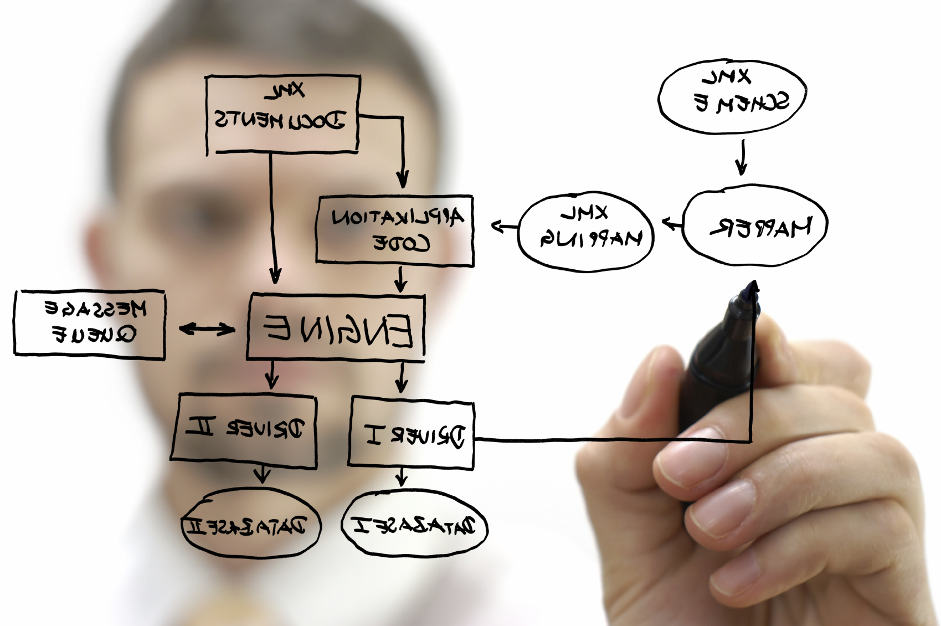
Process
DevOps
Team Communication
Testing
Notes:
Whiteboarding
Got the use cases together and selected some for a MVP
Put PBIs into VSTS
Split the work out into logical groups (discovery, transfer protocol, iOS sharing targets, distribution, etc.)
Team Meetings after every sprint
Constantly checking the latest code across devices, as team members would test against each other as they developed their part of the app.
Tried creating a Slack, but we were all within 1m of each other so not required.
----
Visual Studio Team Services
Continuous Integration
Continuous Delivery
Continuous Monitoring
Kanban
Hockey App
Xamarin Test Cloud
Perfecto

Slide 6
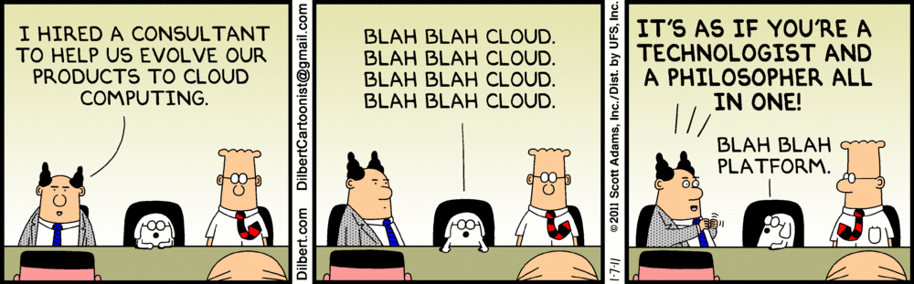
Lessons Learned
Notes:
Lessons Learned
AllJoyn only has native implementations, it doesn’t have generic Xamarin implementation.
Short sprints work well at a hackathon – increases focus and delivery
Peer to peer authentication without a trusted host is NOT easy.
Xamarin build on VSTS can be tricky – consumed all 240 minutes of free build hours trying to debug it.
Run profiler on the code for bottlenecks optimizations
Issues around Azure functions – bindings when using web hooks. Can’t use parameters.
When analyzing DevOps tools we found Xamarin test cloud only supports iOS and Perfecto on supports UWP apps.
Deciding on DevOps tools is a process in and of itself.

Slide 7

Sprints
 |  | Planning Meeting | Sprint Time
✓ | Sprint 0 | Sat 11:15-11:30 | Sat 11:30-13:15
✓ | Sprint 1 | Sat 13:45-14:00 | Sat 14:00-16:15
✓ | Sprint 2 | Sat 16:15-16:30 | Sat 16:30-18:45
✓ | Sprint 3 | Sun 08:15-08:30 | Sun 08:30-10:45
✓ | Sprint 4 | Sun 10:45-11:00 | Sun 11:00-13:15
✓ | Sprint 5 | Sun 13:15-13:30 | Sun 13:30-15:45

Slide 8
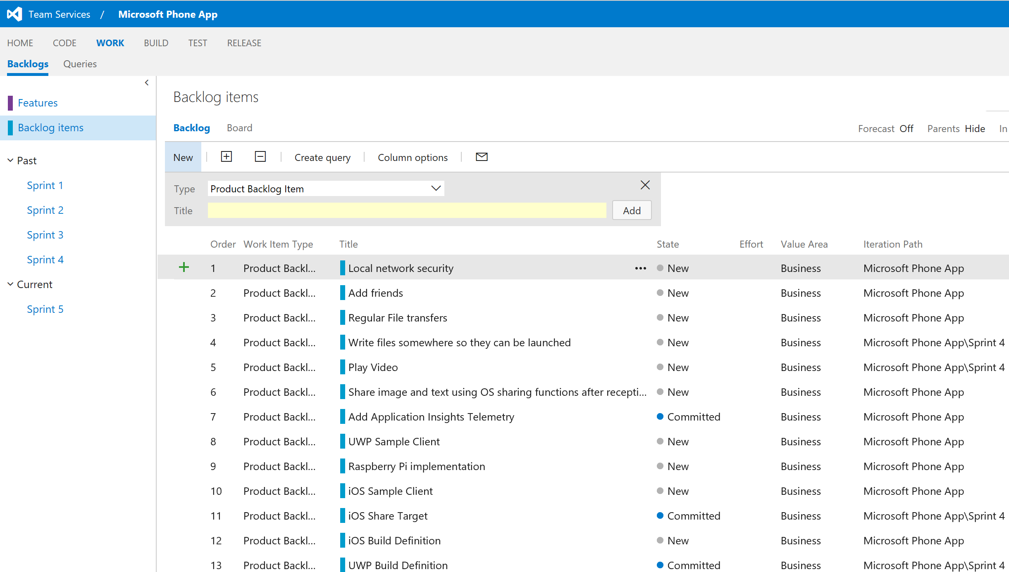

Slide 9

Use Cases
Add your first bullet point here
Add your second bullet point here
Add your third bullet point here
Notes:
Use Cases
Consumers purchase with multiple devices in mind
We all have multiple devices
And we want all our files on those devices instantly
Have you ever had to send something to yourself via email
Online tools such as OneDrive may not be available or will take time to sync

Slide 10


DevOps
Visual Studio Team Services
Continuous Integration
Continuous Delivery
Continuous Monitoring
Kanban
Hockey App
Xamarin Test Cloud
Perfecto
DevOps
Notes:
Visual Studio Team Services
Continuous Integration
Continuous Delivery
Continuous Monitoring
Kanban
Hockey App
Xamarin Test Cloud
Perfecto

Slide 11
Notes:
Demo Step

